Slide 1
Template Instructions Microsoft PowerPoint

Slide 2
Copyright compliance
If you wish to make copyright material available to students, please ensure you have read and are compliant with the University's copyright obligations.
For more information on copyright and rights to use images, please visit the Copyright Office.
Note: You should include a general copyright statement (© University of Melbourne 2023) on your final slide.

Slide 3
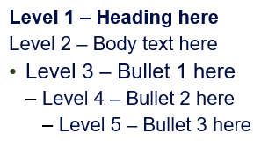
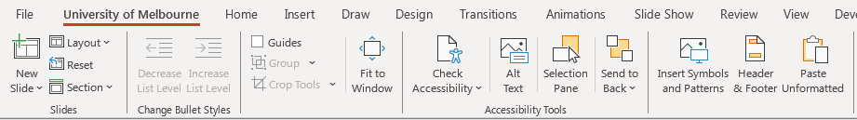
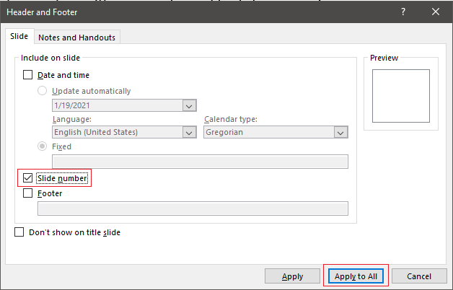
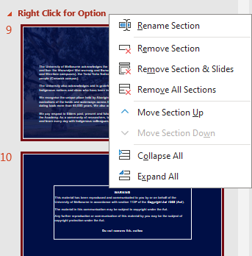
The Customised Ribbon
A customised ribbon has been set up with commonly used tools for convenience. These tools can also be found in their normal locations.
Inserting new slide:
Click New Slide and all the available layouts will be shown as previews.
Click on the thumbnail of the layout that you wish to use.
Using the bullet structure:
Use the Decrease and Increase List Level buttons from the customised tab to access the in-built bullet levels and ensure consistent formatting.
Example of text levels:
Send to back:
Use the Send to back or Bring to front buttons to change the layering of objects
Open the Selection Pane to view the current layers. Layers will be read from bottom to top by assistive technologies. User arrow keys to arrange order.
Sections:
You can use this feature to organise your presentation into sections.
You can select, hide, present, print specific sections.
Editing Footer & Date details:
Click on the Header & Footer button.
Tick Slide number > Apply to All button to apply changes to all slides. OR Apply to only apply to the slide you are on.
Cropping Images:
Use the Fit button under Crop Tools to resize a picture proportionally to the placeholder
Check Accessibility:
Click on the Check Accessibility dropdown to see the options.
Click on the Alt text button to add alternative text for the object
Insert Symbols and Patterns:
Click on the Insert Symbols and Patterns button.

Slide 4
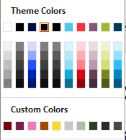
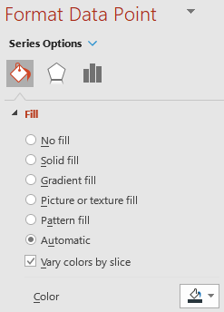
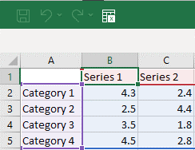
Charts and colours
Colour swatches
Understanding colour swatches can make all the difference to the efficiency of creating a presentation.
Colour swatches work together across all Microsoft Office products and can save you time when integrating content across each product.
Text, headings or fills
Accent Colours
1
2
3
4
5
6
The swatches above are mainly used for headings, body text tables, or other elements.
The above swatch colours will not be used automatically when populating charts.
These Custom Colours are additional colours of University of Melbourne.
Charts will automatically be coloured in the order shown above unless they have been changed manually.
If the colours are not being picked up correctly in this order ensure the data points Fill colour is set to Automatic.
In some circumstances it may be necessary to select the graph, Right Click and “Reset to match style” NOTE: Make sure you make a duplicate copy of your slide or chart as this will remove manual formatting to the graph.
Changing the graph data:
Double click on the pre-built graph.
An Excel data sheet will appear where you will be able to alter the data.
Close the excel file when you have finished editing the data to get back to the PowerPoint.
Important Note: If copying charts from existing excel workbooks please be aware that the whole spread sheet will be embedded in the presentation. Therefore you may prefer to paste as a picture.

Slide 5
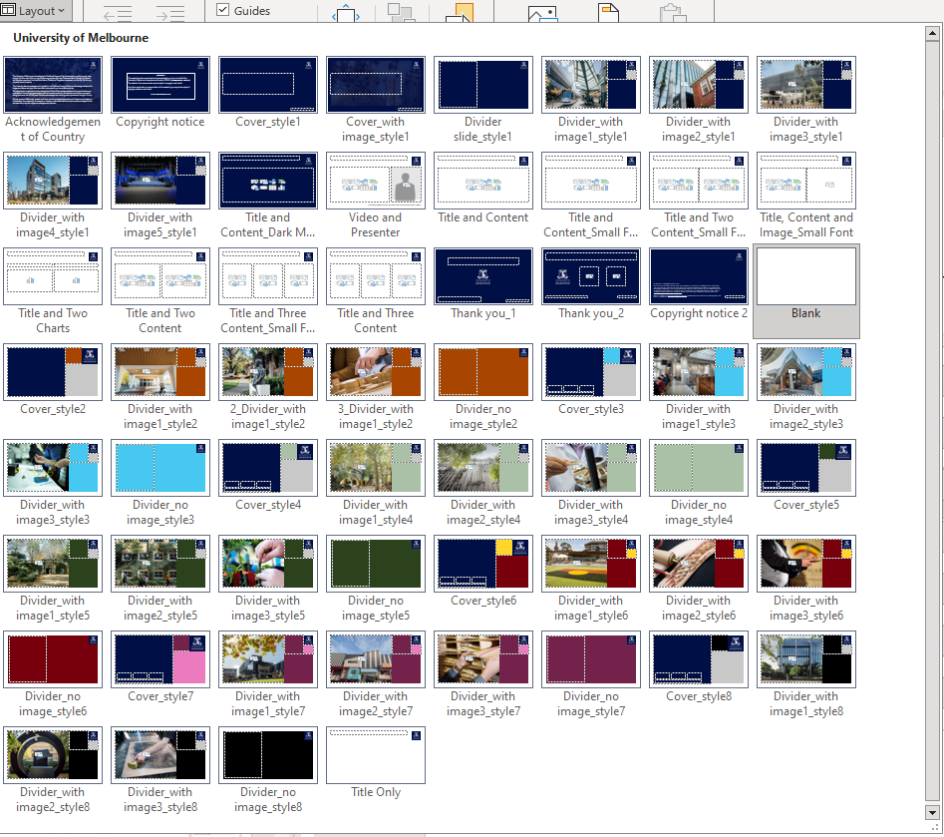
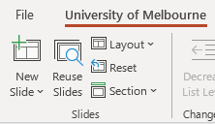
Using different layouts
Use the Layout button to change your selected slide to a different type of background.
It is important that you use the placeholders provided. This ensures consistent formatting is used, and allows your slides to easily adapt to new layouts.
Tip If you have used the placeholders provided, you can click the Reset button to reformat the slide back to the correct formatting.
The presentation may have pre-built slides which are formatted based on the brand guidelines. Use these slides as a starting point for your presentation, if they are not required you can delete them. However, if you run the template again these pre-built slides will be available to you again.
Copy and paste any pre-built slides as required.
Tip When selecting a different layout via the Layout button, click and drag from the corner to expand the window.

Slide 6
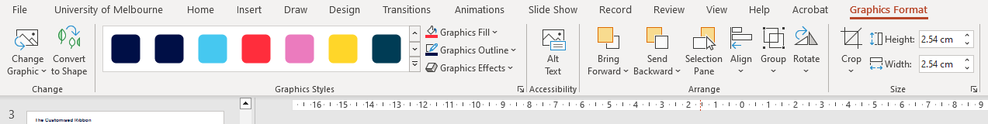

















Icons for infographics
Use the icons available in PowerPoint (>Insert>Icons). You may change their colour by selecting the icon and using the “Graphics Fill” button under “Graphics Format”. Keep icon styles to thin and lightweight, being mindful of accessibility.

Slide 7
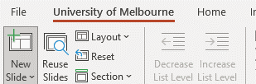
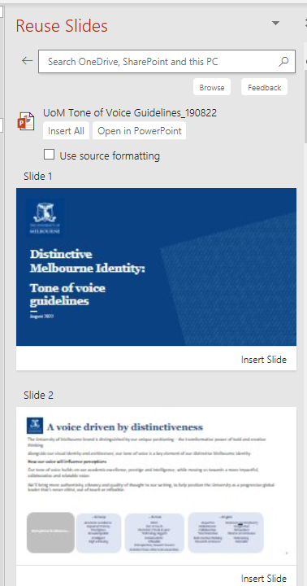
Convert existing PowerPoints into the new template
Save this PowerPoint template to your computer.
Run this template by double clicking on it or Right click -> Choose New.
Select “Reuse Slides”.
A Reuse Slides box will open on the right of your main PowerPoint screen.
In the Reuse Slides box, click the “Browse” button”.
Locate the PowerPoint presentation to be converted on your computer
Click "Open".
A thumbnail image of your original slides will appear in the “Reuse Slides” box.
Ensure the “Use source formatting” box is unticked.
Click “Insert All”.
Your original slides will appear as new slide pages in the new PowerPoint template.
Most standard text slides will convert automatically to the new format.
More complex slides may need minor adjustments to follow the new format.
Use the “Layout” button to select the appropriate slide master for every slide
This process may result in masters from the old presentation being available to users, so these should be deleted from the masters once converted.
Save and name your new PowerPoint presentation.

Slide 8
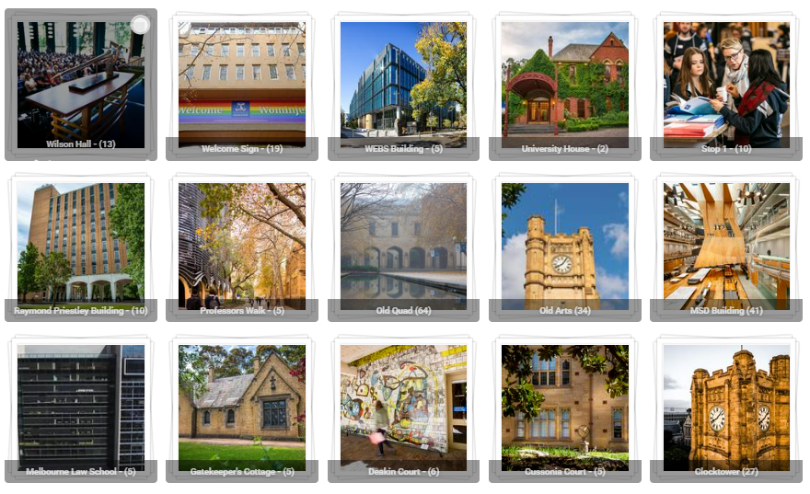
Use of imagery & photographic style
The University of Melbourne photography style
The University’s photography takes on a photo-journalistic, candid style infused with an optimistic tone. This relatable, welcoming approach is authentic and unpretentious and seeks to hero the strong connections the University has between its people, its places, and its own place and impact in the world. The University strives to ensure imagery is appropriate for all audiences and is observant and respectful of differences in interpretation and meaning.
Visit the Brand Hub for more information and to review the Imagery Guidelines
Tips for selecting and sourcing imagery
Always try and use imagery that reflects the University’s photographic style as imagery created specifically for the University helps build a consistent and distinctive visual narrative.
Try not to rely on nondescript stock imagery from external stock libraries as it can look out of place within the University’s visual identity.
Before seeking external stock imagery, please check Imagebank or your faculty marketing contact for curated imagery.
Externally sourced stock imagery must still meet the University’s photographic style.
If there are no suitable images on Imagebank or through your faculty marketing team, always consider whether it is best to not use an image at all.
Use of stock imagery must be compliant with all applicable laws, University policy, and industry codes of practice (including imagery sourced under royalty free or Creative Commons licenses). For more information on copyright and rights to use images, please visit the Copyright Office (copyright.unimelb.edu.au/services).
Imagebank
Imagebank (University Staff only) is a photographic resource that houses a wide range of up-to-date images to suit all communications purposes. Images from Imagebank are free for all University staff to use across marketing and communications materials.

Slide 9
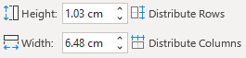
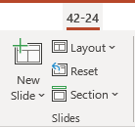
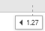
PowerPoint shortcuts
Tips & Tricks
Repeat last action
F4
Repeats the last action made
Superscript
CTRL, SHIFT, +
Toggles superscript on selected text
Distribute rows and columns evenly
Distributes the selected rows or columns evenly in the table
Sections
Create or remove sections within the presentation
Reset Slide
Resets the selected slide into the placeholder positions , and corrects text formatting
(Note: This may remove any manual text formatting)
Hide Slide
Hide a slide from a presentation (On the Slides panel, Right Click > Hide Slide)
Add extra guides
Check Guides on the ribbon. Click a horizontal or vertical guide, hold CTRL and drag when the cursor changes to a + (see left) (Drag a guide off the edge of the screen to remove)

Slide 10
Please remember to delete these instruction slides when they are no longer required They will be available when you run the template again

Slide 11

Acknowledgement of Country

Slide 12
Copyright Warning
WARNING
This material has been reproduced and communicated to you by or on behalf of the University of Melbourne in accordance with section 113P of the Copyright Act 1968 (Act).
The material in this communication may be subject to copyright under the Act.
Any further reproduction or communication of this material by you may be the subject of copyright protection under the Act.
Do not remove this notice

Slide 13
Title goes here

Slide 14
Title goes here
CRICOS

Slide 15
Hidden slide Title goes here

Slide 16
Hidden slide Title goes here

Slide 17
Hidden slide Title goes here

Slide 18
Hidden slide Title goes here

Slide 19
Title goes here

Slide 20
Title goes here
Level 1 – Heading here
Level 2 – Body text here
Level 3 – Bullet 1 here
Level 4 – Bullet 2 here
Level 5 – Bullet 3 here

Slide 21
Title goes here
Level 1 – Heading here
Level 2 – Body text here
Level 3 – Bullet 1 here
Level 4 – Bullet 2 here
Level 5 – Bullet 3 here

Slide 22
Title goes here
Level 1 – Heading here
Level 2 – Body text here
Level 3 – Bullet 1 here
Level 4 – Bullet 2 here
Level 5 – Bullet 3 here

Slide 23
Title goes here
Level 1 – Heading here
Level 2 – Body text here
Level 3 – Bullet 1 here
Level 4 – Bullet 2 here
Level 5 – Bullet 3 here

Slide 24
Title goes here
Level 1 – Heading here
Level 2 – Body text here
Level 3 – Bullet 1 here
Level 4 – Bullet 2 here
Level 5 – Bullet 3 here
Level 1 – Heading here
Level 2 – Body text here
Level 3 – Bullet 1 here
Level 4 – Bullet 2 here
Level 5 – Bullet 3 here

Slide 25
Title goes here
Level 1 – Heading here
Level 2 – Body text here
Level 3 – Bullet 1 here
Level 4 – Bullet 2 here
Level 5 – Bullet 3 here
Level 1 – Heading here
Level 2 – Body text here
Level 3 – Bullet 1 here
Level 4 – Bullet 2 here
Level 5 – Bullet 3 here

Slide 26
Title goes here
Level 1 – Heading here
Level 2 – Body text here
Level 3 – Bullet 1 here
Level 4 – Bullet 2 here
Level 5 – Bullet 3 here
Level 1 – Heading here
Level 2 – Body text here
Level 3 – Bullet 1 here
Level 4 – Bullet 2 here
Level 5 – Bullet 3 here
Level 1 – Heading here
Level 2 – Body text here
Level 3 – Bullet 1 here
Level 4 – Bullet 2 here
Level 5 – Bullet 3 here

Slide 27
Title goes here
Level 1 – Heading here
Level 2 – Body text here
Level 3 – Bullet 1 here
Level 4 – Bullet 2 here
Level 5 – Bullet 3 here
Level 1 – Heading here
Level 2 – Body text here
Level 3 – Bullet 1 here
Level 4 – Bullet 2 here
Level 5 – Bullet 3 here
Level 1 – Heading here
Level 2 – Body text here
Level 3 – Bullet 1 here
Level 4 – Bullet 2 here
Level 5 – Bullet 3 here

Slide 28
Title goes here
Level 1 – Heading here
Level 2 – Body text here
Level 3 – Bullet 1 here
Level 4 – Bullet 2 here
Level 5 – Bullet 3 here

Slide 29
Title goes here
Heading here
Heading here

Slide 30
Title goes here
Table heading here
Table heading | Table heading | Table heading | Table heading | Table heading
Table text | Table text | Table text | Table text | Table text
Table text | Table text | Table text | Table text | Table text
Table text | Table text | Table text | Table text | Table text
Table text | Table text | Table text | Table text | Table text

Slide 31
Title goes here
Table heading here
Table heading | Table heading | Table heading | Table heading | Table heading
Table text | Table text | Table text | Table text | Table text
Table text | Table text | Table text | Table text | Table text
Table text | Table text | Table text | Table text | Table text
Table text | Table text | Table text | Table text | Table text

Slide 32
Title goes here
Table heading here
Table heading | Table heading | Table heading | Table heading | Table heading
Table text | Table text | Table text | Table text | Table text
Table text | Table text | Table text | Table text | Table text
Table text | Table text | Table text | Table text | Table text
Table text | Table text | Table text | Table text | Table text

Slide 33
Copyright Notice
(c) The University of Melbourne
2023
This material is protected by copyright. Unless indicated otherwise, the University of Melbourne owns the copyright subsisting in the work. Other than for the purposes permitted under the Copyright Act 1968, you are prohibited from downloading, republishing, retransmitting, reproducing or otherwise using any of the materials included in the work as standalone files. Sharing University teaching materials with third-parties, including uploading lecture notes, slides or recordings to websites constitutes academic misconduct and may be subject to penalties. For more information: Academic Integrity at the University of Melbourne
Requests and enquiries concerning reproduction and rights should be addressed to the University Copyright Office, The University of Melbourne: copyright-office@unimelb.edu.au
The University of Melbourne (Australian University) PRV12150/CRICOS 00116K

Slide 34
Title goes here
[Copyright, CTA or other information/notices]
The University of Melbourne (Australian University) PRV12150/CRICOS 00116K

Slide 35
Title goes here
The University of Melbourne (Australian University) PRV12150/CRICOS 00116K
[Copyright, CTA or other information/notices]

Slide 36
Blank layout, free from default text object

